Slide 1

FCNN: Fusion of Convolutional Neural Networks for
Object Tracking
VGIS 842
Péter Rohoska
Louise Abela
Cédric Magnan
VGIS Exam 2017

Slide 2
Agenda
Introduction & Initial Problem
Previous Work (MDNet &TCNN)
Fusion Theory & Architecture
FCNN (Our tracker) Implementation
Final Results
Discussion, Future Work & Conclusion
‹#›

Slide 3
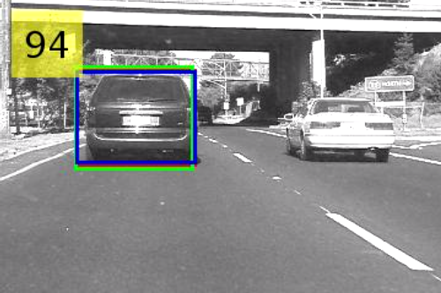
Introduction
Object Tracking
Object tracking is a fundamental task in CV (Atonomous driving systems)
Trend shifted towards CNNs
SoTA algorithms can still be improved under different imaging conditions
Individual trackers handle the conditions differently
‹#›
Notes:
Surveillance systems, robotics, ...

Slide 4
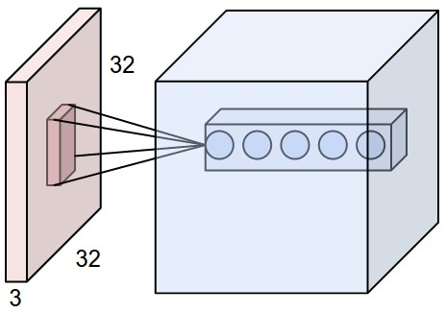
Introduction
CNNs
Handle 2D local structures (visual data)
Activations uncover structural relations
Temporal
Can force the extraction of local features
Best under imaging conditions
‹#›

Slide 5

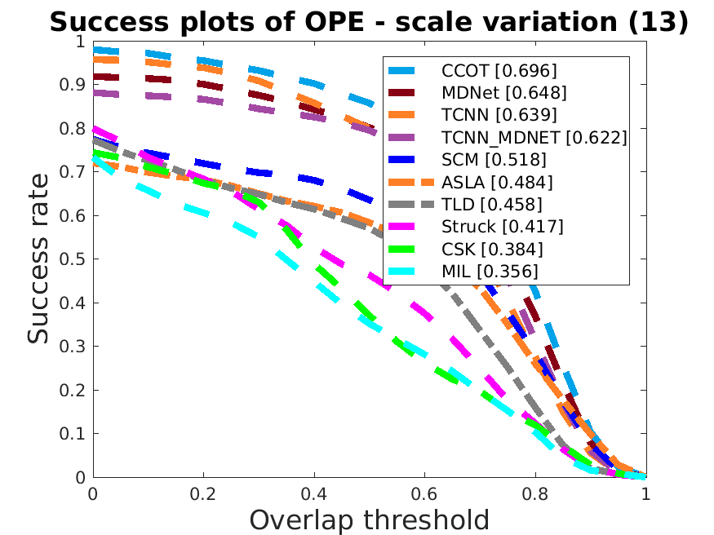
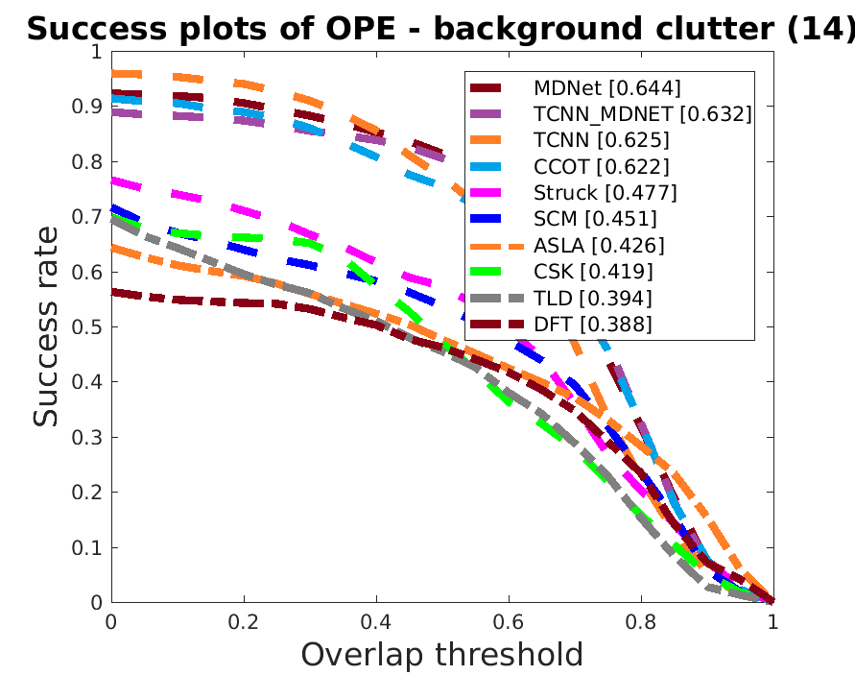
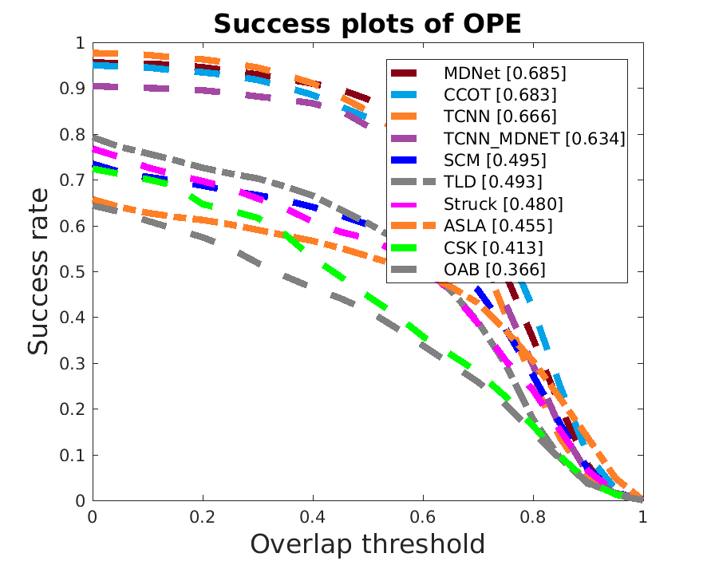
Problem Formulation
BC
SV
OCC
IV
LR
DEF
MB
FM
Overall
IPR
OPR
OV
OTB-50

Slide 6
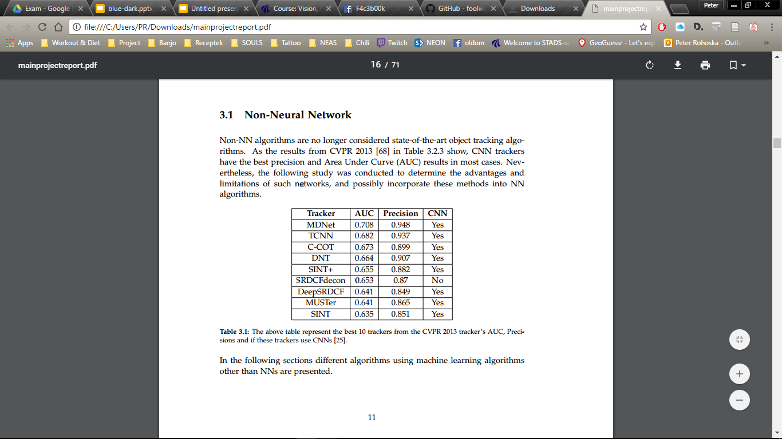
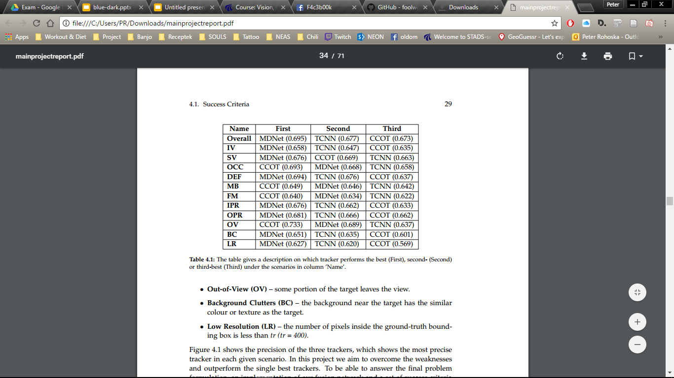
Problem Formulation
Success and precision results on OTB-50.
Notes:
Report page 29. last paragraph!!!

Slide 7
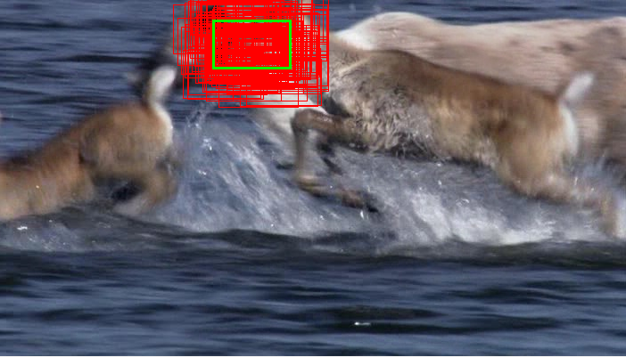
Shared Implementation Details
Theory and Re-Implementation
Initial finetuning based on samples generated around the first frame’s target position
Train a bbox regression model on the first frame and
update it short term and long term
Perform online updates every 10th frame (different for TCNN)
Mean bounding box between the sampled bounding boxes with the 5 best scores.
Notes:
init finetuning :
5000 negative samples
500 positive samples
Regression
10000 samples

Slide 8
Trackers
Theory and Re-Implementation
MDNet
TCNN
Multi-Domain training
Features from shared layers represent domain independent information
Maintain multiple CNNs
Stores appearence change in a tree structure
‹#›

Slide 9
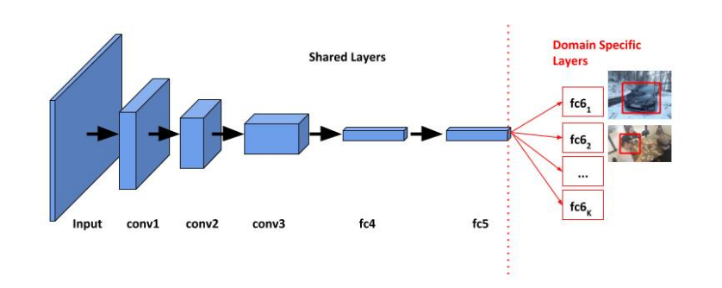
MDNet
Theory and Re-Implementation
Multi domain training method
Maintain multiple domain specific layers
After training on K amount of sequences it has K domain specific
layers
Train the network with respect to each domain iteratively to obtain generic target representations in the shared layers
At the end of testing all domain specific layers are discarded and replaced by a binary classification layer

Slide 10
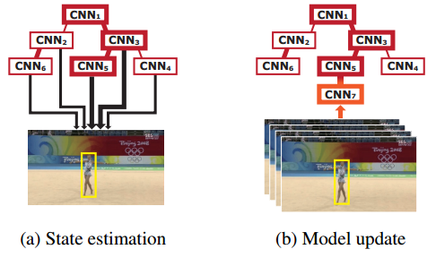
TCNN
Theory and Re-Implementation
Uses a VGG-M network pretrained on ImageNet
Maintains a tree-structure of CNNs in nodes during
tracking based on target appearence change
The proposed algorithm is effective to handle multi-modal target appearances, short-term occlusions and tracking
failures.
The final target state is estimated by identifying the best
sample in terms of a weighted average score from a set
of active CNNs
During tracking online updates are performed along the
active CNNs
Notes:
We maintain multiple CNNs in a tree structure, where a CNN is stored in each node. This approach improves multimodality of appearance models by having CNNs in diverse branches while it preserves model reliability by smoothly updating CNNs along the path in the tree.
Figure 1: Illustration of target state estimation and model update procedures using multiple CNNs maintained in a tree structure. The width of a black arrow indicates the weight of a CNN for target state estimation while the width of a red edge denotes the affinity between two CNNs. The width of box outline means the reliability of the CNN associated with the box.
Online updates: We create a node z for the new CNN after finishing tracking ∆(= 10) consecutive frames without model updates, which are elements in Fz. The parent CNN is the one to maximize the reliability of the new CNN,

Slide 11
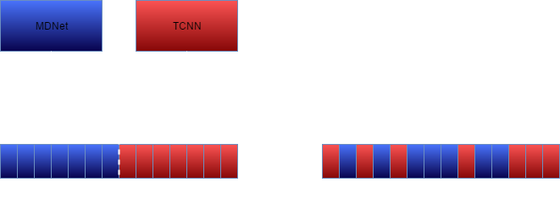
Combination of Scores

Slide 12

Fusion of CNNs

Slide 13
Fusion of CNNs
Ensemble
Create a stronger classifier with the use of multiple weak ones!
Weak classifiers are not able to perform robust tracking by themselves.
Has previously shown potential (AdaBoost)
Aggregate the prediction from classifiers.
For example tree structures
-> partitions the space of target object appearances (or equivalently the feature space) by using a binary tree, with a separate base tracker at each node (Gundogdu et al.).
Weaknesses:
Increased storage
Increased computation
Decreased comprehensibility
Notes:
The first weakness, increased storage, is a direct consequence of the requirement that all component classifiers, instead of a single classifier, need to be stored after training. The total storage depends on the size of each component classifier itself and the size of the ensemble (number of classifiers in the ensemble). The second weakness is increased computation: to classify an input query, all component classifiers (instead of a single classifier) must be processed, and thus it requires more execution time. The last weakness is decreased comprehensibility. With involvement of multiple classifiers in decision-making, it is more difficult for users to perceive the underlying reasoning process leading to a decision.

Slide 14
Fusion of CNNs
Fusion Networks
Partition feature space
(fx. RGB-D)
Fusion of features from the same feature space
Through fusion of CNNs can we learn a more robust classifier through training?
Late fusion (concatenating the last conv layers) of CNNs is a rare method for tracking
We don’t need increased storage, but computation time increases (more for training).
The decision method can be learned and needs fine tuning later (fx. Increasing the weights of better features -> scale layer) More on this later!

Slide 15
Fusion of CNNs
Fusion Architecture
Stream Layers
Two streams, take the same input with same measures (batch size (for training), image size, channels)
Both streams end at the last conv layer
Remove softmax response after conv layer
Output has to be the same size (apply fx. zero padding to)
Frozen weights in the streams, do not propagate back here
Conv_y
Conv_x
Concat.
fc.
fc.
fc.

Slide 16
Fusion of CNNs
Fusion Architecture
Fusion layers
Concatenate features from streams (2x the size of conv layer)
Fully connected layers (3) + ReLU(2) and Softmax
Fc layers progressively reduce the size
Batch normalization after the fully connected layers
More robust to bad initialization
Conv_y
Conv_x
Concat.
fc.
fc.
fc.

Slide 17
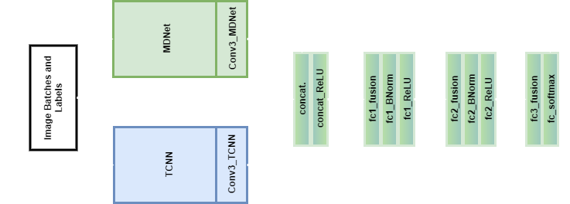
Fusion of CNNs
Fusion Architecture

Slide 18
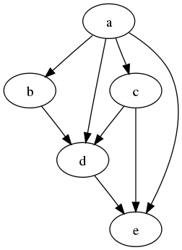
Fusion of CNNs
Directed Acyclic Graphs (DAG)
Directed Acyclic Graphs (DAG)
DAG allows functions to have any number of inputs or outputs
Variables and parameters can have an arbitrary number of outputs (a parameter with more of one output is shared between different layers), meaning it allows the concatenation of two network streams.
Initiate one stream, stop at the last convolutional layer, execute the second stream, and then continue with the concatenation
Available in MatConvNet!

Slide 19

Implementation of FCNN

Slide 20
d
Iterations
Iterations
2(+1) for training
3 for tracking
VOT2016 for training
OTB50 test the network
‹#›

Slide 21
Our first training algorithm
Create network
Add new layers
Load Sequences
Evaluate
For each epoch and sequence get batches run through the network, evaluate
and update weights
Creating a DAGNN network and load the pre-trained models
Fully connected, batch normalization, activation and loss layers
Information including image list, ground-truths.
Shuffle frames.
‹#›
Notes:
VOT2016 was used to train the network
o Network option – batch size 256, batch frames 8, epochs 75
o Creating a DAGNN network by loading the pre-trained models and add the
layers, parameters and variables
o Add fully connected, batch normalization, activation and loss layers to the
network
o Load sequences information including image list, ground-truths
o Shuffle the frame list and create list of frames for each epoch
o For each epoch and sequence get batches run through the network, evaluate
and update weights

Slide 22
Our first training algorithm
Create network
Add new layers
Load Sequences
Evaluate
For each epoch and sequence get batches run through the network, evaluate
and update weights
Fully connected, batch normalization, activation and loss layers
Information including image list, ground-truths.
Shuffle frames.
Creating a DAGNN network and load the pre-trained models
‹#›
Notes:
VOT2016 was used to train the network
o Network option – batch size 256, batch frames 8, epochs 75
o Creating a DAGNN network by loading the pre-trained models and add the
layers, parameters and variables
o Add fully connected, batch normalization, activation and loss layers to the
network
o Load sequences information including image list, ground-truths
o Shuffle the frame list and create list of frames for each epoch
o For each epoch and sequence get batches run through the network, evaluate
and update weights

Slide 23
Our first training algorithm
Create network
Add new layers
Load Sequences
Evaluate
For each epoch and sequence get batches run through the network, evaluate
and update weights
Fully connected, batch normalization, activation and loss layers
Information including image list, ground-truths.
Shuffle frames.
Creating a DAGNN network and load the pre-trained models
‹#›
Notes:
VOT2016 was used to train the network
o Network option – batch size 256, batch frames 8, epochs 75
o Creating a DAGNN network by loading the pre-trained models and add the
layers, parameters and variables
o Add fully connected, batch normalization, activation and loss layers to the
network
o Load sequences information including image list, ground-truths
o Shuffle the frame list and create list of frames for each epoch
o For each epoch and sequence get batches run through the network, evaluate
and update weights

Slide 24
Our first training algorithm
Create network
Add new layers
Load Sequences
Evaluate
For each epoch and sequence get batches run through the network, evaluate
and update weights
Fully connected, batch normalization, activation and loss layers
Information including image list, ground-truths.
Shuffle frames.
Creating a DAGNN network and load the pre-trained models
‹#›
Notes:
VOT2016 was used to train the network
o Network option – batch size 256, batch frames 8, epochs 75
o Creating a DAGNN network by loading the pre-trained models and add the
layers, parameters and variables
o Add fully connected, batch normalization, activation and loss layers to the
network
o Load sequences information including image list, ground-truths
o Shuffle the frame list and create list of frames for each epoch
o For each epoch and sequence get batches run through the network, evaluate
and update weights

Slide 25
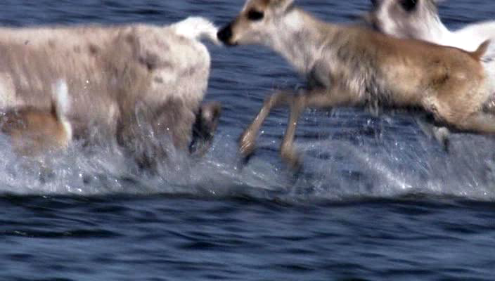
Our first tracking algorithm
Load the trained model.
Input = 256 samples around target from the previous frame.
For each frame in the sequence get 256 scores from the end of the network, sort the scores, get the mean of the top 5 samples.

Slide 26
Our second tracking algorithm
Bounding Box Regression
Network model is the same!
Tracking Algorithm:
Train bounding box regression model on first frame (linear regression model)
Continue the same process as first tracker but in the end when a target is found adjust the bounding box using the regression model.

Slide 27
Our third tracking algorithm
Bounding Box Regression
+ Online Updates
Network model is the same!
Tracking Algorithm:
Generate short term (every 20) and long term (every 100) samples.
Finetune the network every 10 frames.
Use long term positive and short term negative samples.
Notes:
if f +(x ∗ t ) < 0.5 then 19 Update {w4, w5, w6} using S + s and S − s 20 end 21 if tmod10 = 0 then 22 Update {w4, w5, w6} using S + l and S − s 23 end

Slide 28
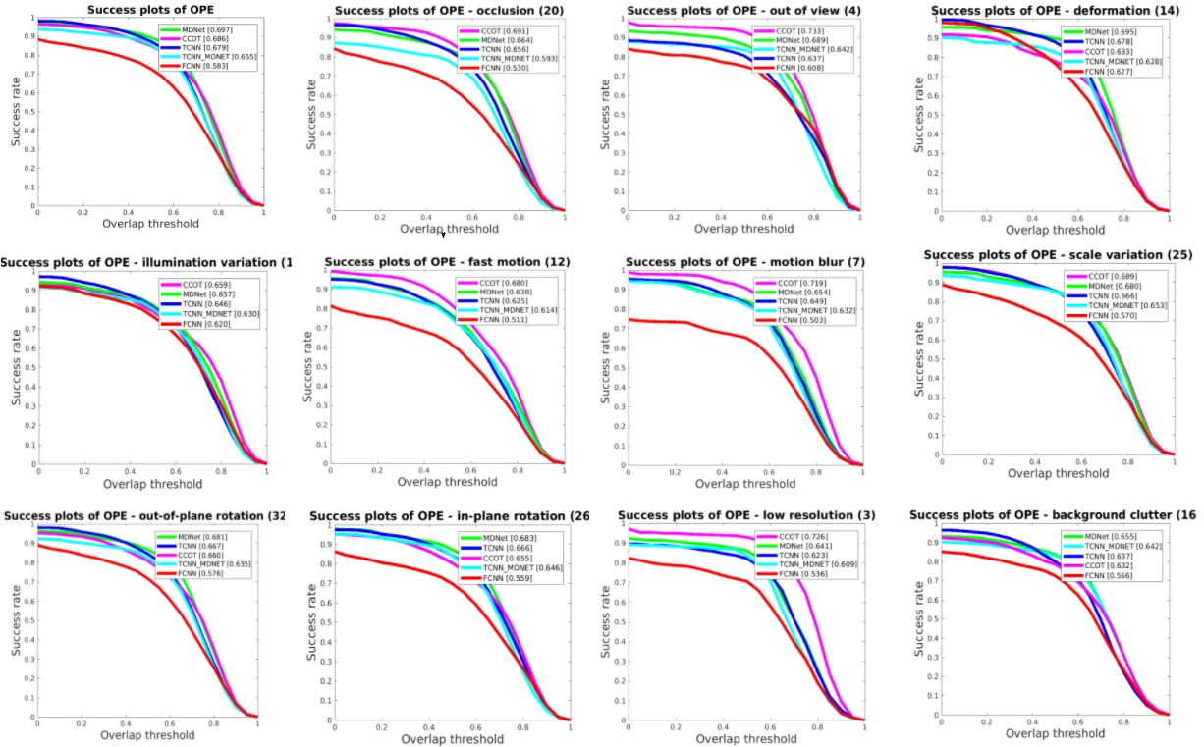
What is pixel reprojection?
‹#›

Slide 29
Our second training algorithm
Label Weight:
Calculated using the benchmark .
If the value is better in MDNet the difference between MDNet and TCNN is multiplied to 1.
All values are added together to get the final weighs.
Experimenting using weights x2 and x10 (discarded x10).
Procedure:
Add additional information from the label files considering the 5 labels (…).
Adding an additional layer.
Calculating weights by taking the current batch frames (in our case 8) label values, multiply them with the label weight add them up.
‹#›

Slide 30
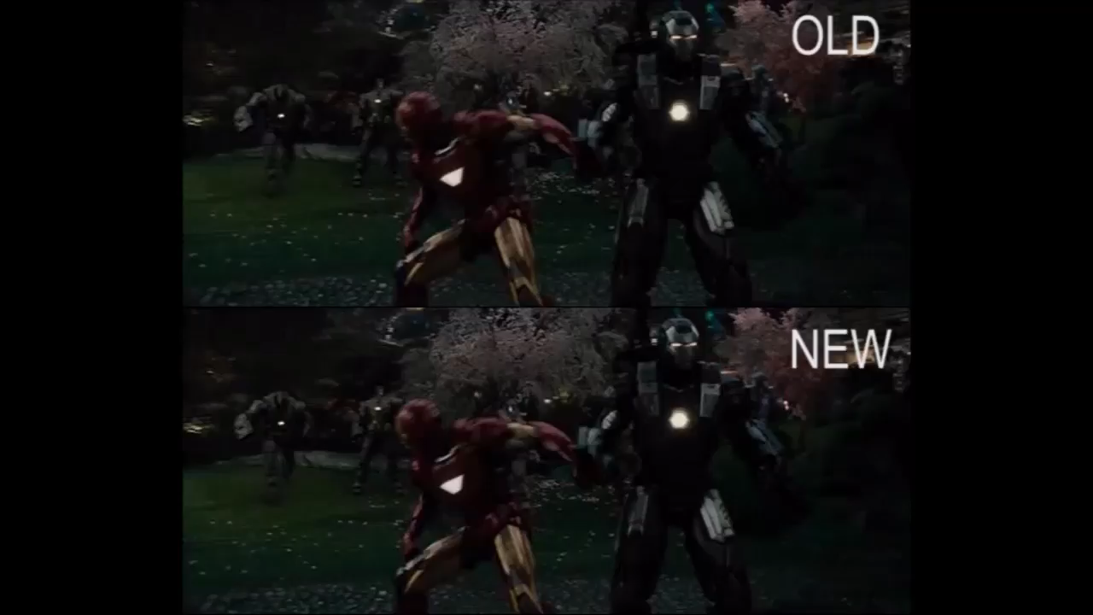
Qualitative Results

Slide 31
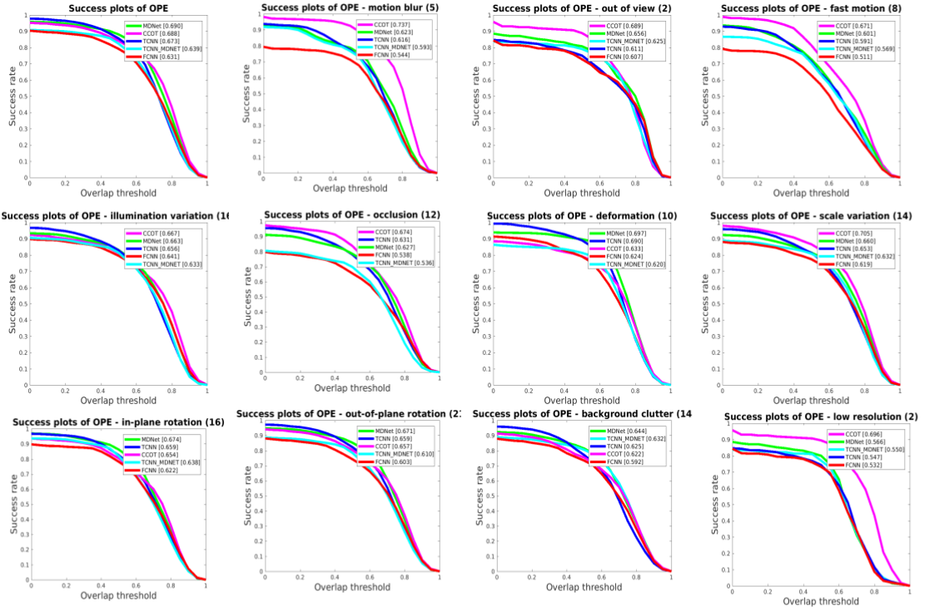

Slide 32
Our third training algorithm
Label Weight:
Calculated using the benchmark .
If the value is better in MDNet the difference between MDNet and TCNN is multiplied to 1.
All values are added together to get the final weights.
Weight by Average All Frames:
Calculating weights by taking all label values for each label (1s and 0s), multiply them with the label weight add them up.
‹#›

Slide 33

Final Results

Slide 34
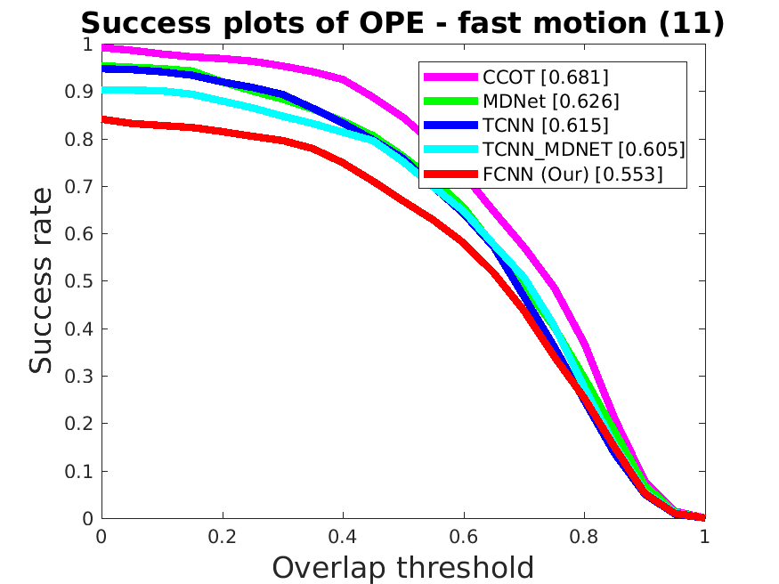
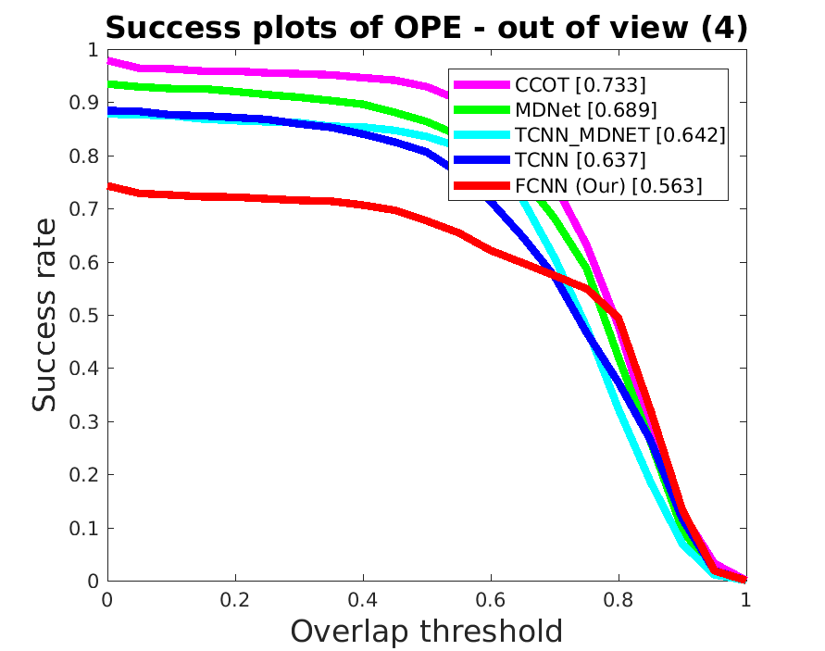
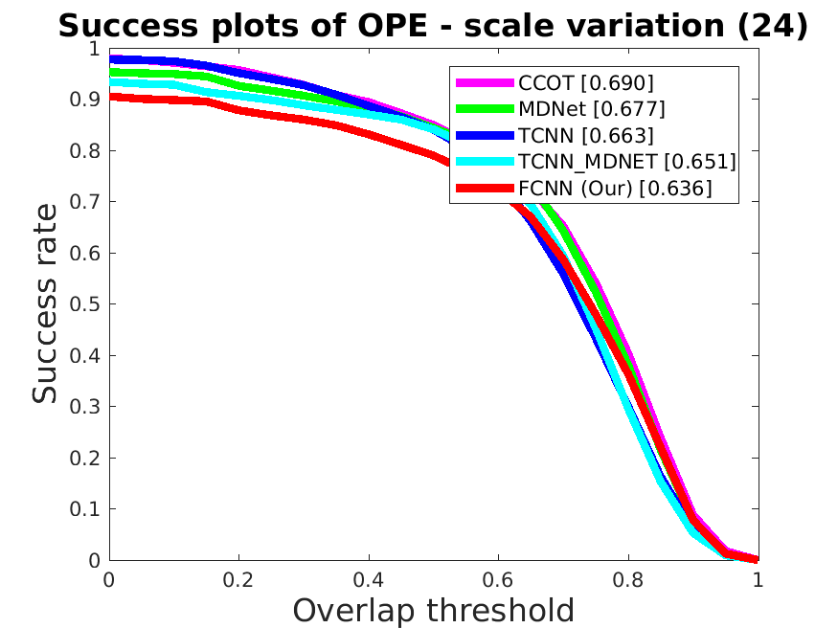
Final Results

Slide 35
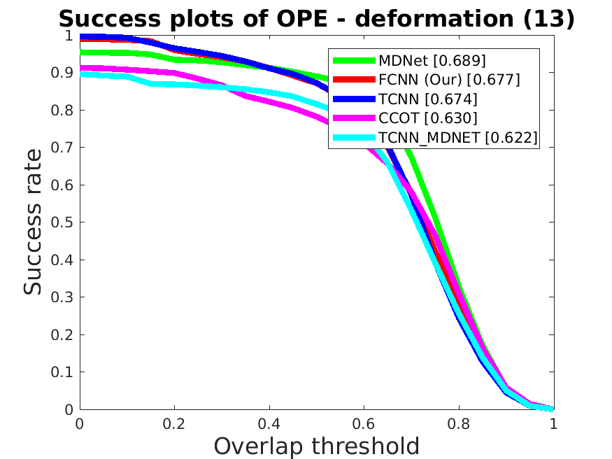
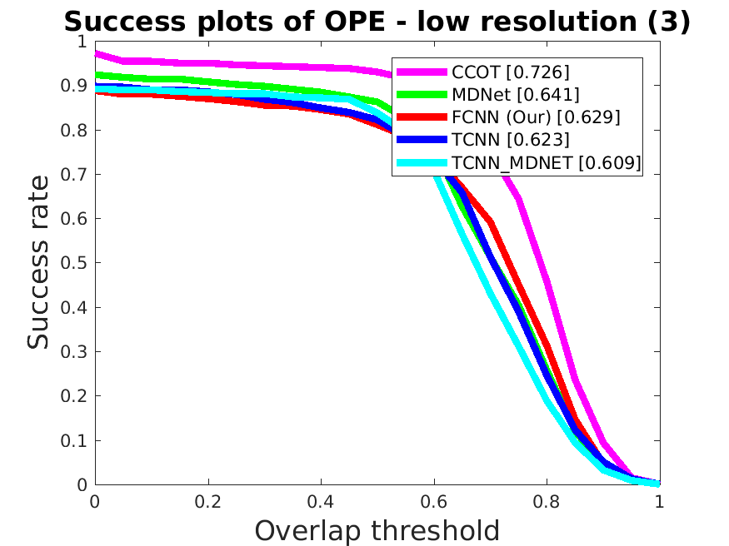
Final Results

Slide 36
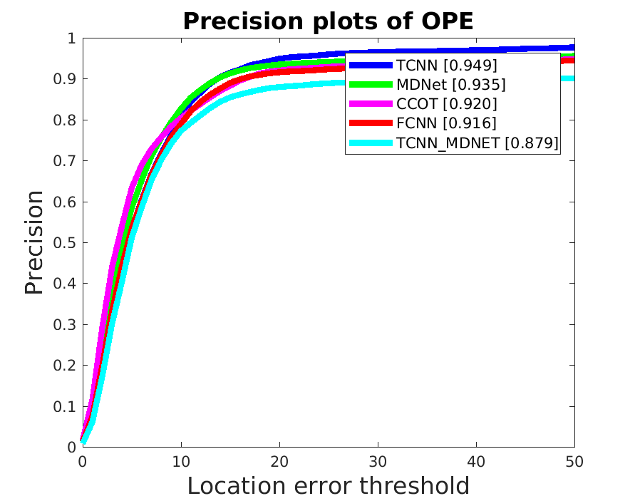
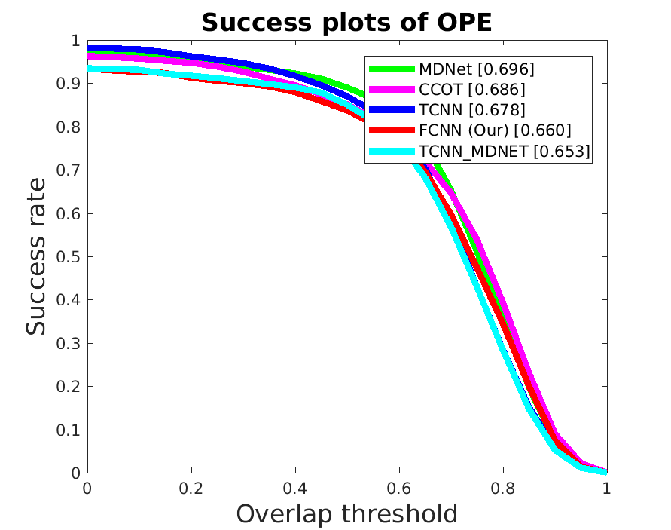
Final Results

Slide 37
Quantitative Results
Overall Scores
Tracker | AUC | Precision
MDNet | 0.696 | 0.935
CCOT | 0.686 | 0.920
TCNN | 0.678 | 0.949
FCNN | 0.660 | 0.916
TCNN_MDNet | 0.653 | 0.879
FPS (on CPU) | Training
~9.5 sec/frame | 15 hours
‹#›

Slide 38
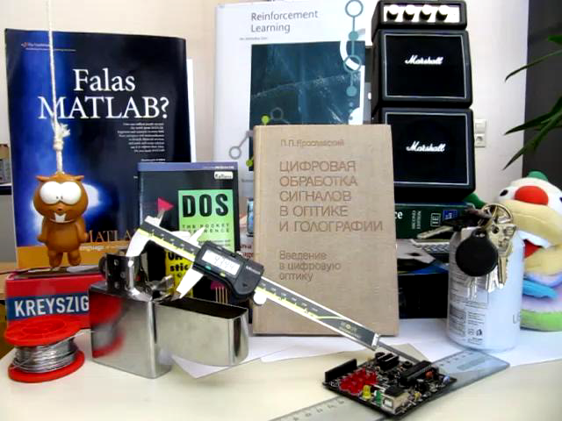
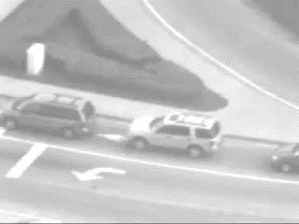
Qualitative Results

Slide 39
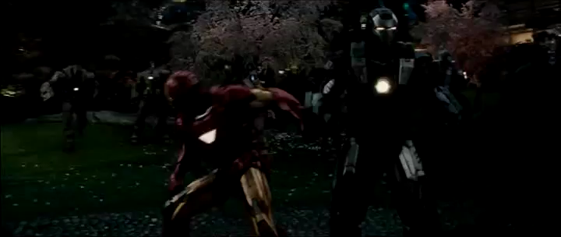
Qualitative Results

Slide 40
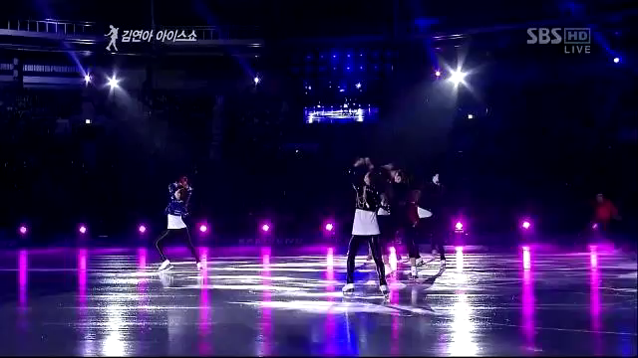
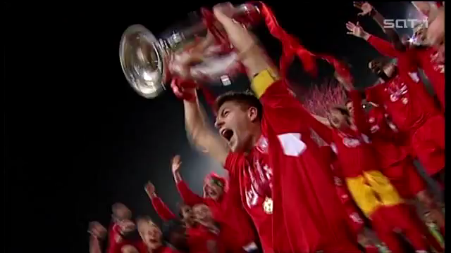
Qualitative Results

Slide 41
Discussion & Future Work

Slide 42
Discussion & Future Work
Training:
Train the last layer of the network multi-domain (sequence specific).
Increase the weights for low success imaging effects.
Use OTB for training (more labels).
Three stream fusion with CCOT or ECO.
‹#›

Slide 43
Discussion & Future Work
Tracking:
Multiple FCNN in tree structure for target state prediction (increase tracking time).
Online updates based on appearence models saved in the tree structure.
Use GPU instead of CPU for tracking (never tried to run it… ☹ ).
Optimization.
‹#›

Slide 44
Discussion & Future Work
MatConvNet:
Use SimpleNN for training and tracking (could increase performance).
Some parts of MatConvNet remain to be a black box.
Some parts of the implementation of TCNN and MDNet remain to be a black box.
‹#›

Slide 45
Conclusion

Slide 46
Conclusion
Presented an architecture for late fusion of CNN trackers performing on the same feature space.
Increased performance with intelligent weighting (still space for improvement).
The tracker reaches SoTA performance compared to other CNN trackers.
FCNN never reaches best results on OTB-50.
‹#›

Slide 47
Thank you!
VGIS 842.
Péter Rohoska
Louise Abela
Cédric Magnan
VGIS Exam 2017

Slide 48
References
http://cs231n.github.io/convolutional-networks/
E. Gundogdu, H. Ozkan, and A. A. Alatan. “Ensemble Of adaptive correlation filters for robust visual tracking”. In: 2016 13th IEEE International Conference on Advanced Video and Signal Based Surveillance (AVSS). 2016 13th IEEE International Conference on Advanced Video and Signal Based Surveillance (AVSS). Aug. 2016, pp. 15–22. doi: 10.1109/AVSS.2016.7738031.
Andrea Vedaldi and Karel Lenc. “MatConvNet - Convolutional Neural Networks for MATLAB”. In: arXiv:1412.4564 [cs] (Dec. 15, 2014). arXiv: 1412 . 4564. url: http://arxiv.org/abs/1412.4564 (visited on 05/27/2017).
‹#›

